Slide 1
Image Analysis

Slide 2
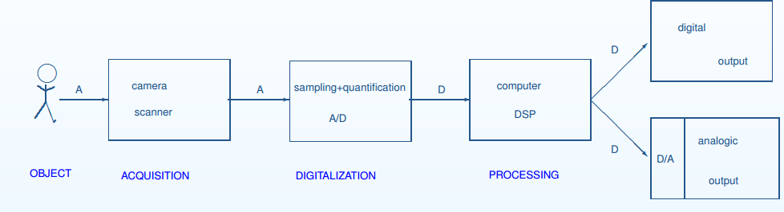
Image Processing
Satellite images give information about natural resources, meteorological data.
Medical images help detect anatomical pathology (Detect cancer cells)
Video surveillance

Slide 3
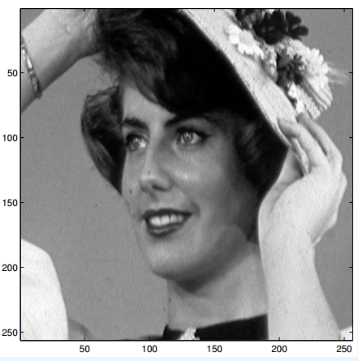
Natural image vs Numerical image ?

Slide 4
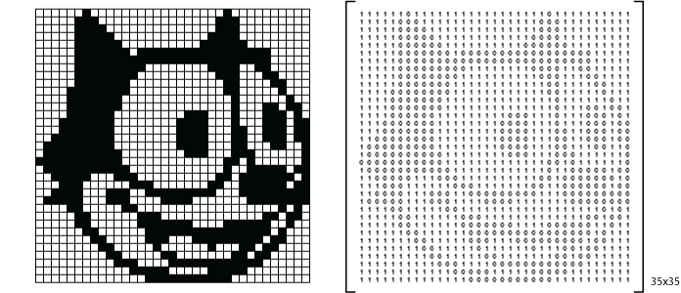
Binary Image

Slide 5
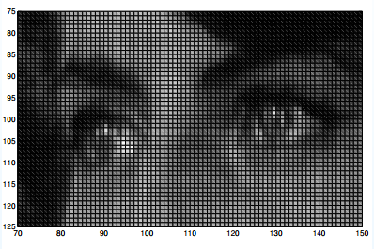
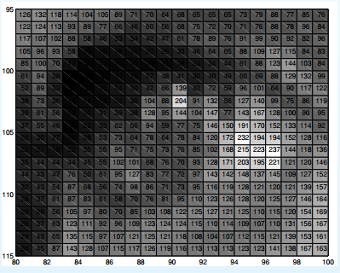
Gray scale image

Slide 6

Color Image – R G B

Slide 7
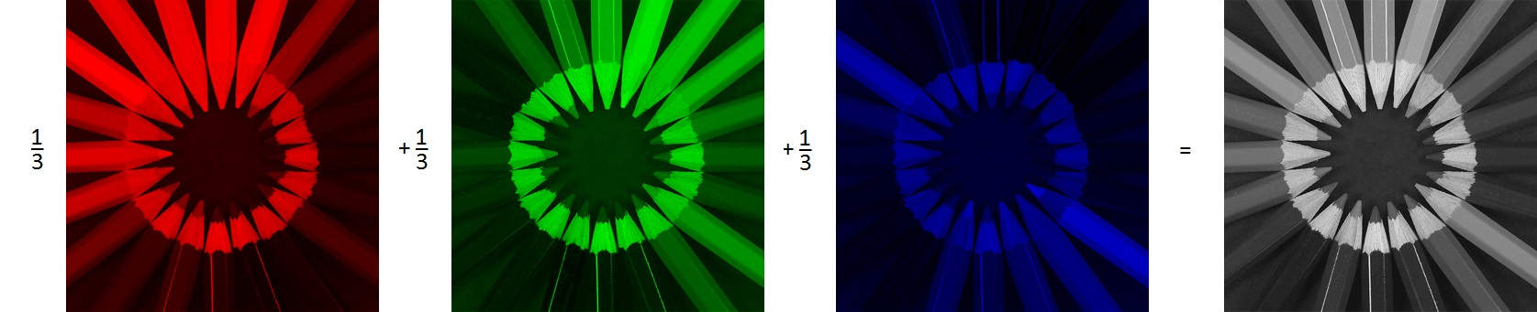
How is a gray scale image formed?

Slide 8
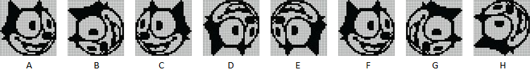
Images are matrices

Slide 9
In image analysis
Low level analysis :
Edges, Corners, de-blurring
High level analysis:
Detect objects, recognize people.

Slide 10
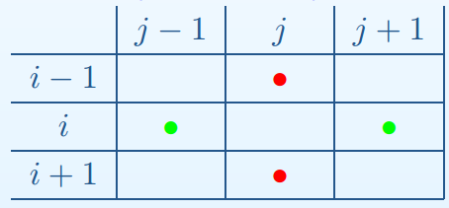
Edge/Contour Detection

Slide 11
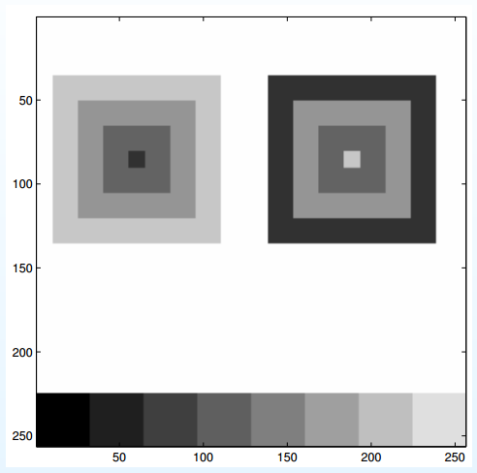
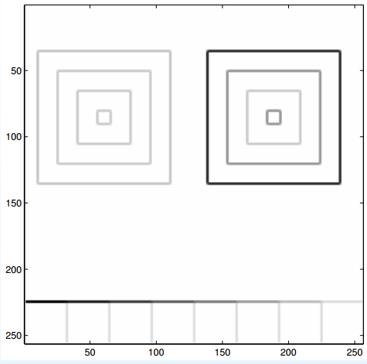
Edge detection

Slide 12
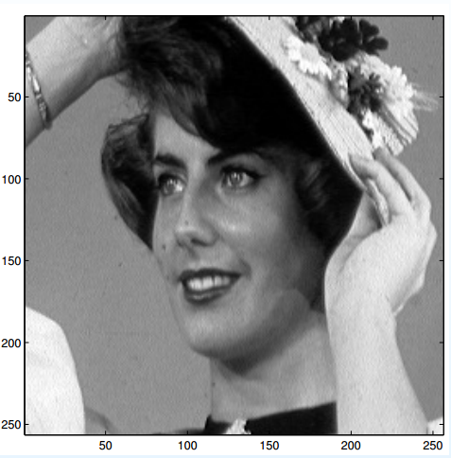
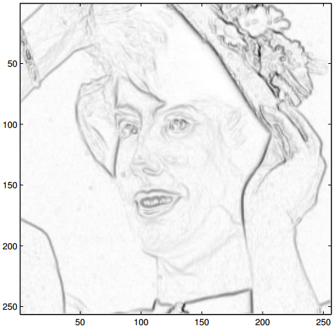

Slide 13
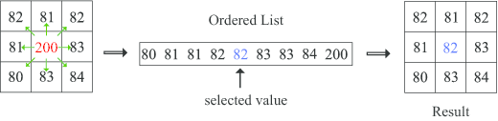
Denoising

Slide 14
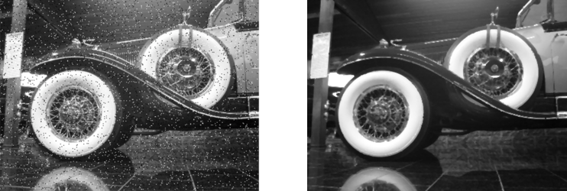

Slide 15
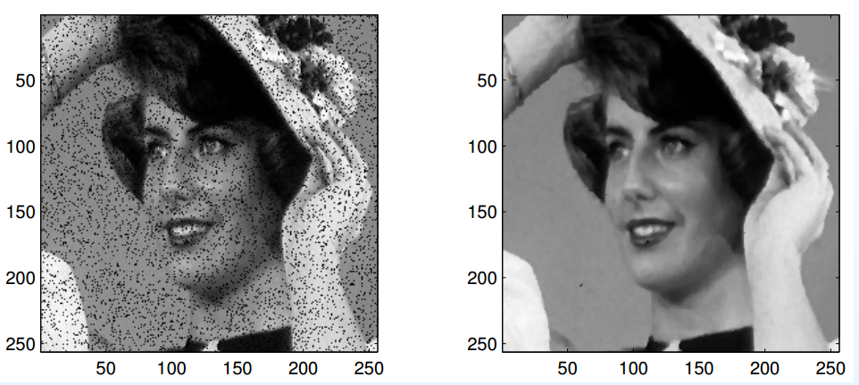

Slide 16
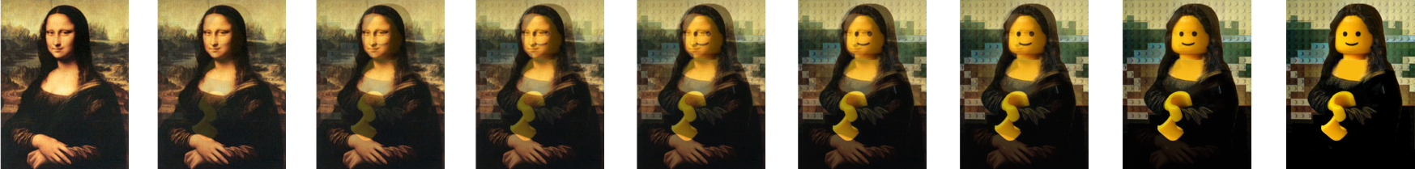
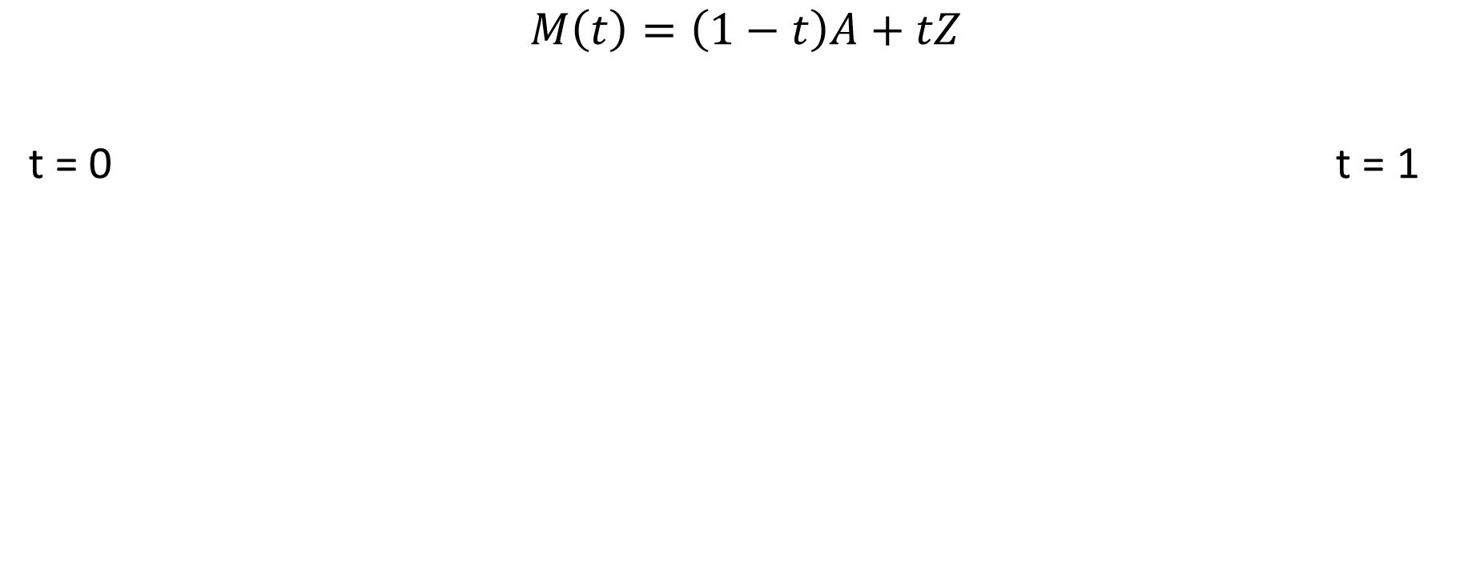
Transitions/Visual Effects
$$M\left(t\right)=\left(1−t\right)A+tZ$$
t = 0 t = 1

Slide 17
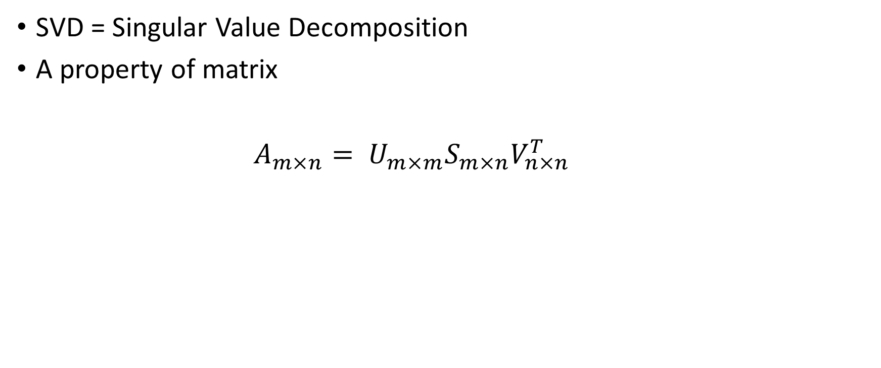
Compression using SVD
SVD = Singular Value Decomposition
A property of matrix
$A_{m×n}= U_{m×m}S_{m×n}V_{n×n}^{T}$

Slide 18
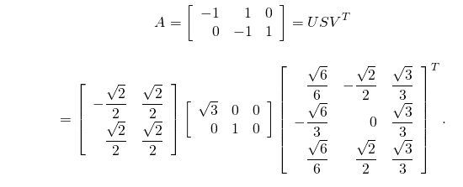
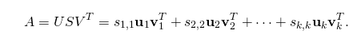

Slide 19
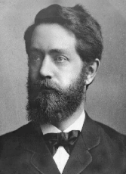
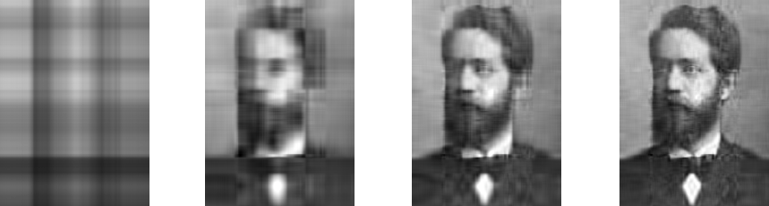
r = 1 r = 5 r = 10 r = 20

Slide 20
Applications
Panaroma – an application of transformation of matrices.
Paint, Photoshop -> many image editing softwares.

Slide 21
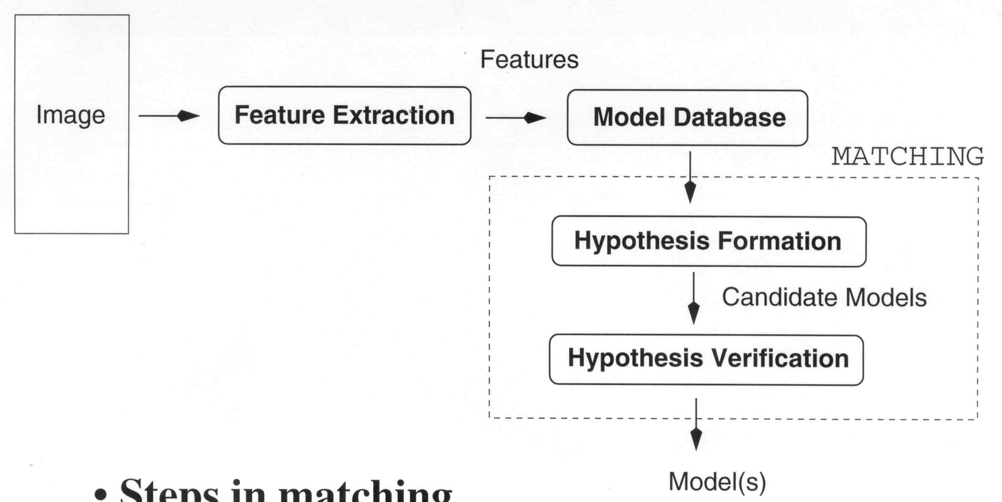
Object Recognition

Slide 22
Feature Extraction
Low level features:
Histogram, Edges, Pixel level values, Local histograms
These are not good features
Change in luminosity, view point, occlusions.

Slide 23
Feature Extraction (contd.)
Higher level features:
SIFT (Scale Invariant Feature Transform)
Invariant to scale, rotation, occlusions
Base of modern computer vision research.
Proposed by Lowe, 2004 , 33146 citations till date.

Slide 24
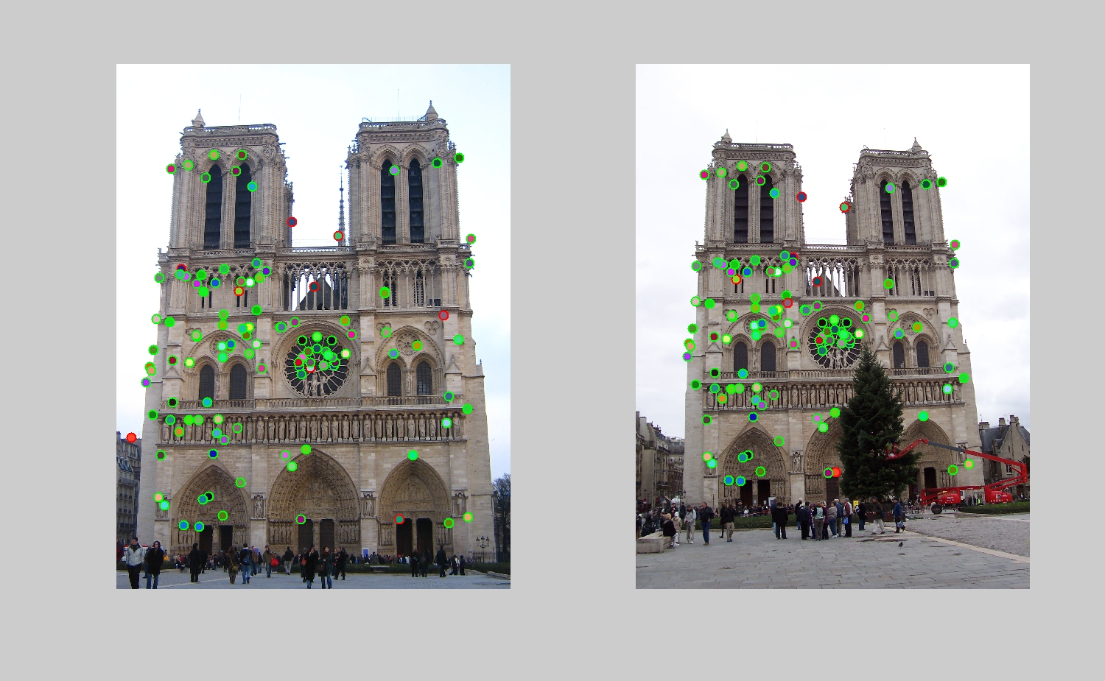

Slide 25
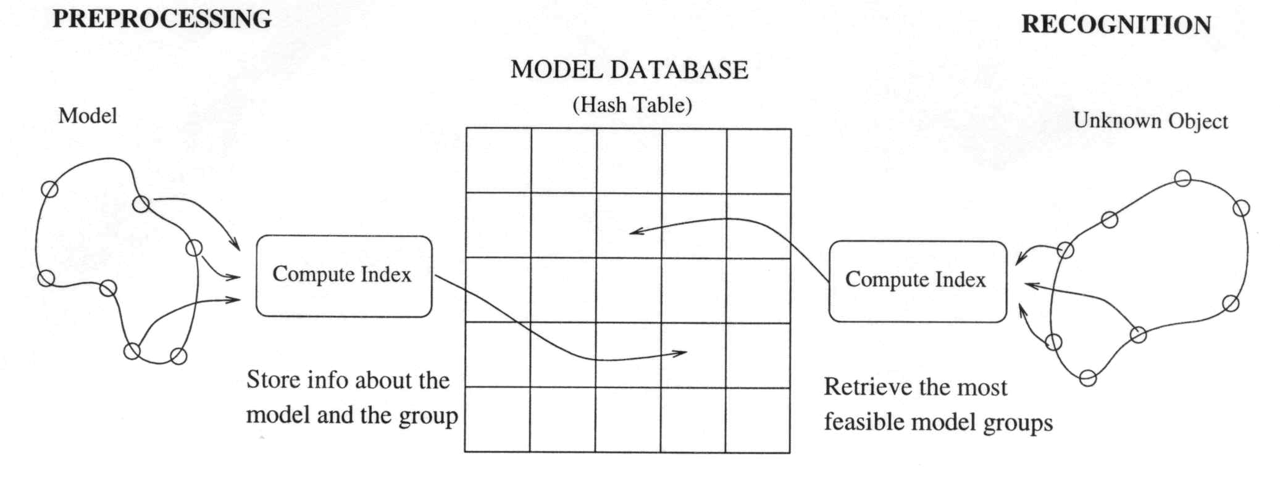

Slide 27
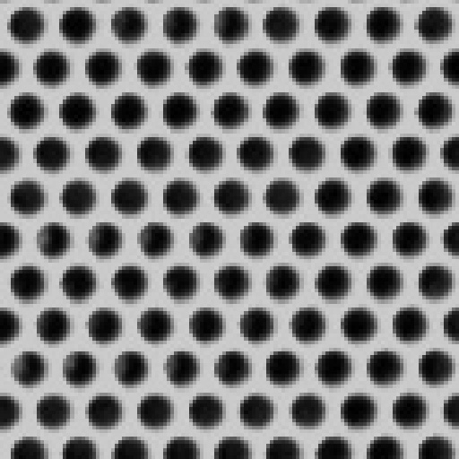
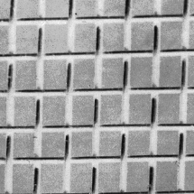
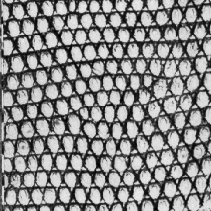
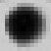


Texture Recogniton

Slide 28
Texture Recognition
histogram

